Slide 1
Exploratory Data Analysis - Project
Stock Price and VIX historical data
Avishek Roy

Slide 2
Goal - Analysis of Netflix (NFLX) & VIX Historical Data
Data Set - 1
Data Set - 2
Data Preparation
Historical data of NFLX has been downloaded by API call to IEXCloud.io.
Data set saved in CSV format.
Historical data of CBOE Volatility index (VIX) has been downloaded in CSV format from Yahoo finance.
Both Data set filter to starting 01-01-2010 date.
Percentage change for past day and week has been calculated.
Joined based on date and selected only required column

Slide 3
Variables in final data set
Variable Name - Definition
open - adjusted open price of stock close - adjusted close price of stock
high - adjusted intra-day highest price of stock low - adjusted intra-day lowest price of stock
volume - volume of stock traded on that day vix_changePercent - change of vix from previous day
changePercent - Change percent from previous trading day
changePercentweekly - Change percent from previous week
vix_open - open price for volatility index
vix_close - close price for volatility index

Slide 4
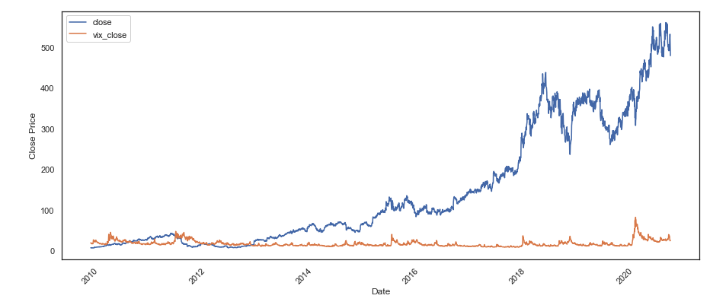
Initial plot of data
NFLX and VIX vs Time

Slide 5
Analysis questions
Questions
How percentage daily changes of stock price ( NFLX ) are distributed in last 10 year.
How percentage Weekly changes of stock price ( NFLX ) are distributed in last 10 year.
What is average and other statistical measures percentage daily and weekly changes.
How percentage daily changes are related to volume of trade of single day.

Slide 6
Statistical measures of Daily close price
NFLX -
mean = final_df.close.mean()
print(mean)
var = final_df.close.var()
print(var)
std = final_df.close.std()
print(std)
median = final_df.close.median()
print(median)
144.6604500548846
21169.32548995111
145.49682295483674
90.26

Slide 7
Statistical measures of Daily changes
NFLX -
mean = final_df.changePercent.mean()
print(mean)
var = final_df.changePercent.var()
print(var)
std = final_df.changePercent.std()
print(std)
median = final_df.changePercent.median()
print(median)
kurtosis = final_df.changePercent.kurtosis()
print(kurtosis)
0.21295279912184412
11.256977112339994
3.3551418915360336
0.0
21.08696165666787

Slide 8
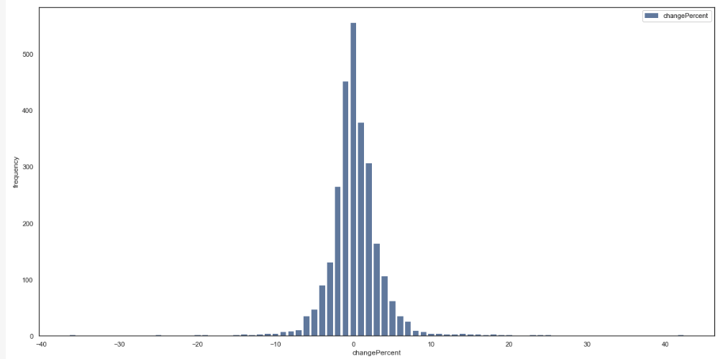
Distribution of Percentage changes
Plot of distribution
Plot seems close to normal distribution with tall peak near zero, that means many days NFLX stock changed very less percentage.
Kurtosis is value is 21, so that means it is sharp peaks.
Checking on outliers , it looks very outliers evenly in both side on plot. Further analysis is required to identify if they occured on Stock earning day or not.

Slide 9
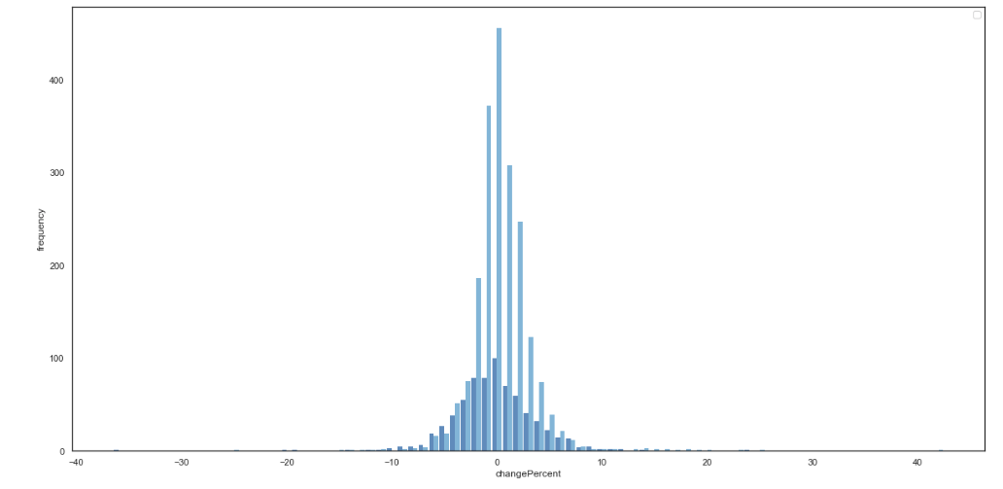
Distribution of Percentage changes with VIX
Plot of distribution when vix is over 20 and Under 20
Assumption is when volatility index is high stock price varies more than usual. Plot distribution is done by splitting data frame into 2 different set.
Dark blue - when VIX < 20
Light blue - when VIX >= 20

Slide 10
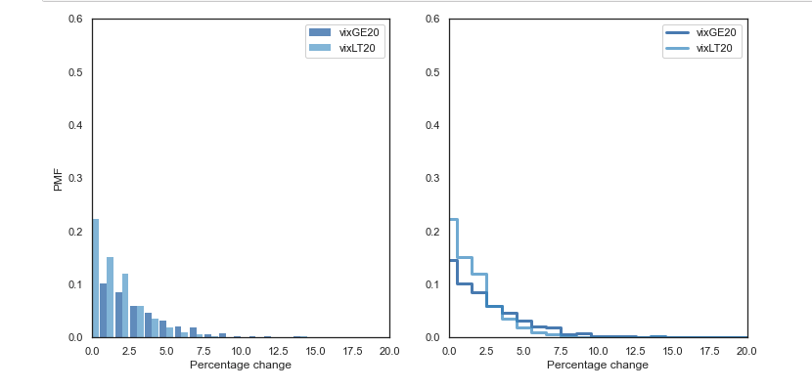
PMF of Percentage change with VIX
Plot of PMF when vix is over 20 and Under 20
Assumption is when volatility index is high stock price varies more than usual. Plot distribution is done by splitting data frame into 2 different set.
Dark blue - when VIX < 20
Light blue - when VIX >= 20
This PMF plot denotes for NFLX stock changes happened most of time with -5 to +5 percentage and decreased slowly after that.

Slide 11
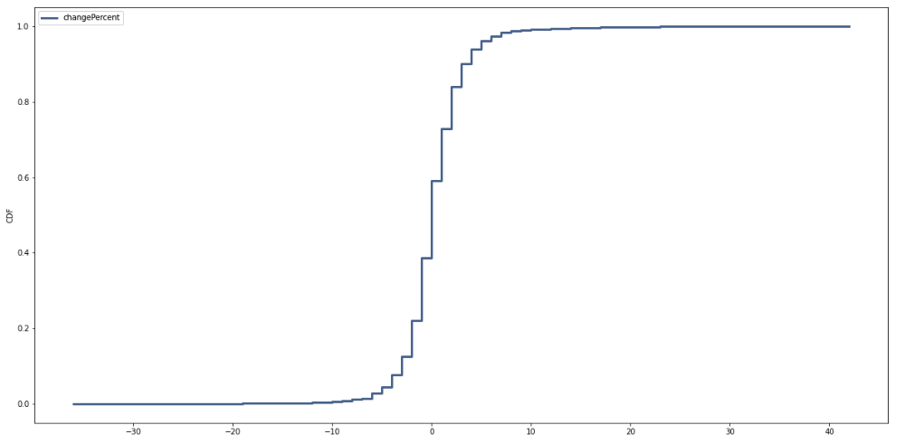
CDF of Percentage change variable
Plot of CDF
A cumulative distribution function (CDF) plots hows the empirical cumulative distribution function of the data. It is an increasing step function that has a vertical jump of 1/N at each value of X equal to an observed value. This CDF plot denotes for NFLX stock changes happened most of time with -5 to +5 percentage.

Slide 12
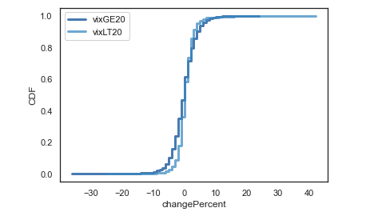
CDF of Percentage change variable - with VIX filter
Plot of CDF
A cumulative distribution function (CDF) plot with 2 set with filter shows when VIX is less than 20 , it is more steeper than when VIX is higher than 20.

Slide 13
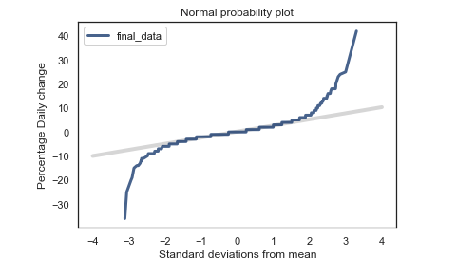
Normal Probability plot
No Probability plot
Plot shows the results for all percentage changes. Both curves match the model near the mean and deviate
in the tails. The more positive changes babies are higher than what the model expects, and more negative changes are lower.

Slide 14
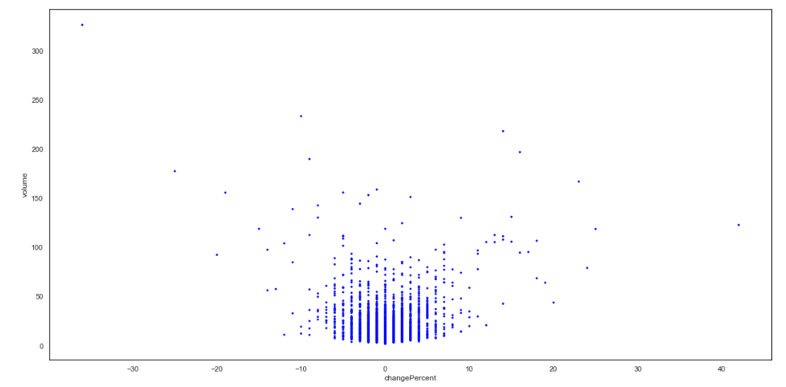
Volume vs Percentage change - Correlation and Causation
No Probability plot
This is scatter plot of Volume of stock traded vs Percentage change.
Correlation Coefficient value is .025 that means it has very slight positive correlation.
Spearman Correlation Coefficient value is .012 which indicates that there is not significant positive association between these 2 variables.

Slide 15
Hypothesis testing
No Probability plot
data = final_df.changePercent.values, final_df.volume.values
ht = CorrelationPermute(data)
pvalue = ht.PValue()
pvalue
P -value calculated - 0.194
P value greater than 0.05 means that no effect was observed.

Slide 16
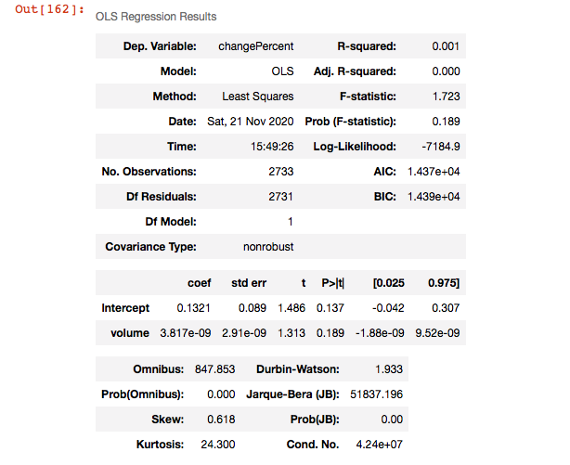
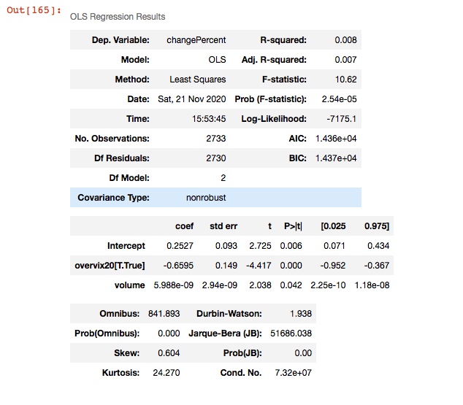
Regression Analysis
NPChange percent vs volume Change percent vs overvix20 + volume
o Probability plot

